Slide 1
DataSpark Project

Slide 2
agenda
Introduction
Exploring the data
Data Management with Mysql
Data Visualization with Power BI
Final Report of Key Insights

Slide 3

Introduction

Slide 4
DataSpark: Illuminating Insights for Global Electronics
This project was provided with several datasets containing information about their customers, products, sales, stores, and currency exchange rates.
The company seeks to leverage this data to better understand their business and identify areas for improvement.
The aim is to identify key insights that will enhance marketing strategies, optimize inventory management, and improve sales forecasting.

Slide 5
Exploring the data
Data Cleaning and Preprocessing: Handling missing values, inconsistencies, and formatting issues.
Normalize Data: Standardize or normalize data to ensure comparability.
Data Visualization: Create visualizations (e.g., histograms, box plots, scatter plots) to explore relationships and patterns.
Correlation Analysis: Identify correlations between variables using correlation coefficients.

Slide 6

Data Management with Mysql
Database Creation: Create a suitable database structure to store the cleaned and preprocessed data.
Data Loading: Load the data into the database using SQL queries.
To gain deeper insights, we'll likely need to merge the tables.
Querying and Manipulation: Write SQL queries to extract, filter, and transform data as needed.

Slide 7
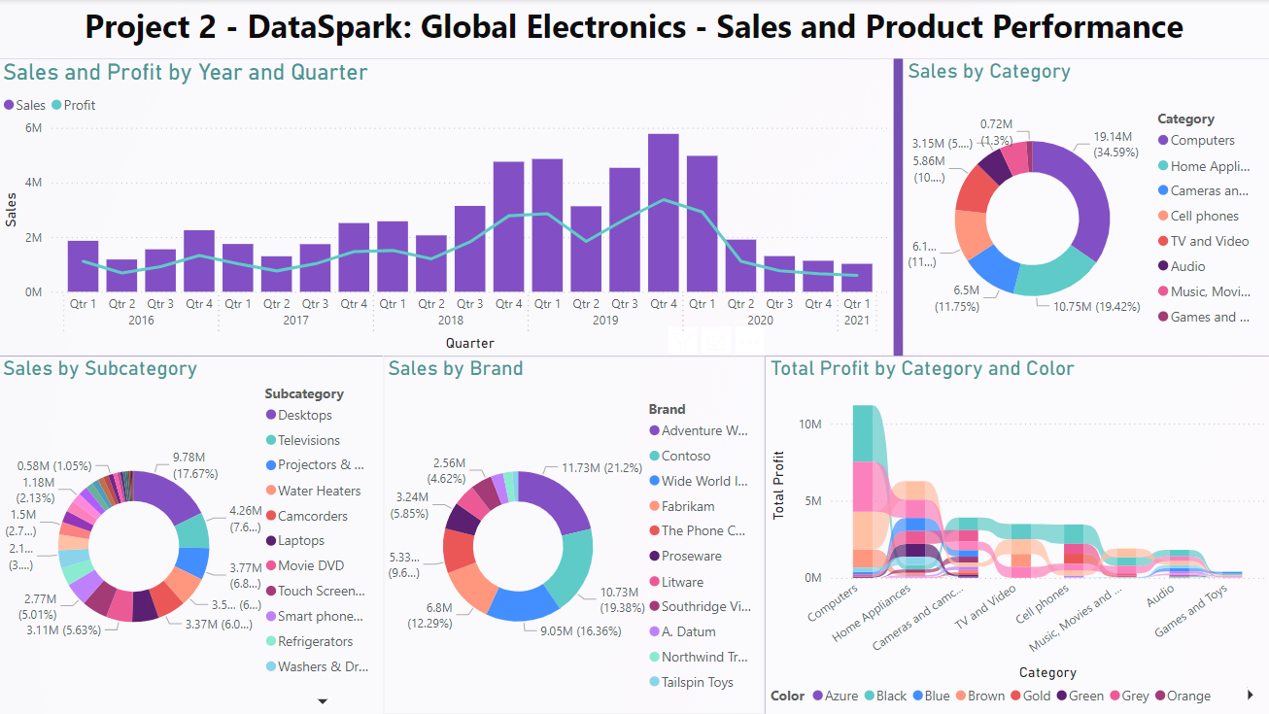
Data Visualization with Power BI
Dashboard Creation: Design interactive dashboards using Power BI
Visualization Selection: Choose appropriate visualizations (e.g., bar charts, line charts, maps) to convey insights effectively.
Data Integration: Connect the dashboard to the SQL database to fetch and display data dynamically.

Slide 8
Final Report of Key Insights
Overall Sales and Profit Trends:
Sales and profit have generally increased over the years, with a significant spike in 2019 and a slight decline in 2020.
Product Performance:
Top-Performing Categories: Computers and Home Appliances consistently contribute the most to overall sales and profit.
Subcategory Dominance: Desktops and Laptops within the Computers category drive significant sales.
Brand Leadership: Adventure Works, Contoso and Wide World Importers are leading brands in terms of total profit.
Profit by Category and Color:
Color Preferences: Black and White products generally contribute more to profit.
Sales and Profit Correlation:
Sales and profit are generally correlated, suggesting a strong relationship between the two.
Product Mix:
The dashboard provides insights into the product mix and helps identify potential areas for diversification.

Slide 9
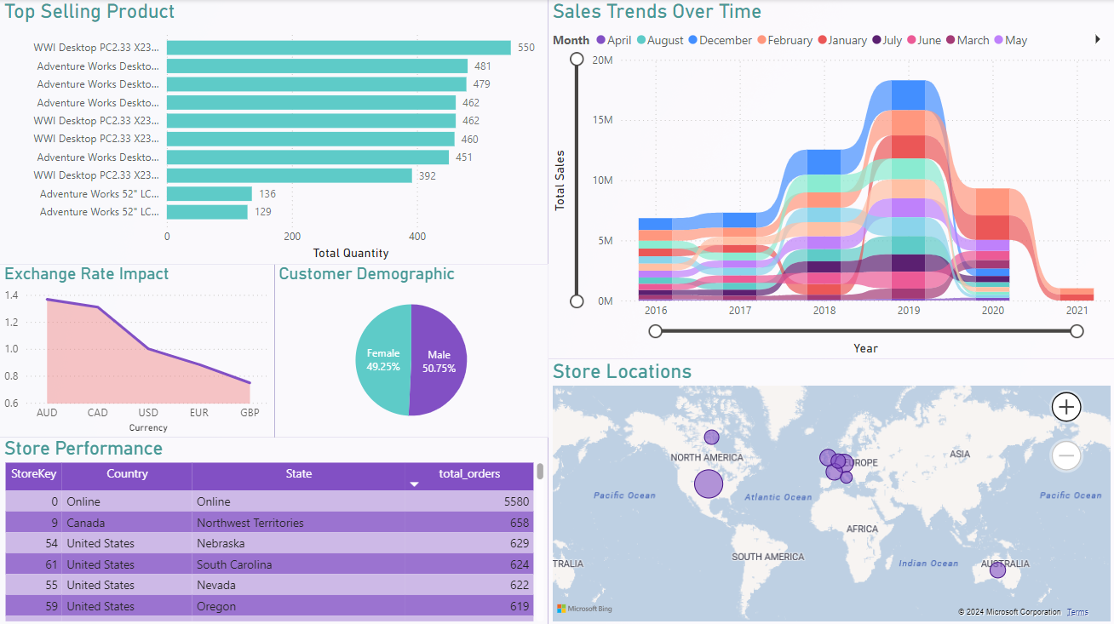
Key Insights
Top Selling Products:
WWI Desktop and Adventure Works Desktops consistently rank as top-selling products.
Exchange Rate Impact:
Fluctuations in exchange rates may have influenced sales, especially for international markets.
Gender Distribution:
The customer base is fairly balanced between males and females.
Store Performance:
The dashboard provides information on total orders for each store, allowing for performance comparisons.
Sales Trends Over Time:
Sales fluctuate throughout the year, with peaks in certain months
Geographic Distribution:
Stores are located in various regions, including North America, Europe, Australia, and South America.

Slide 10
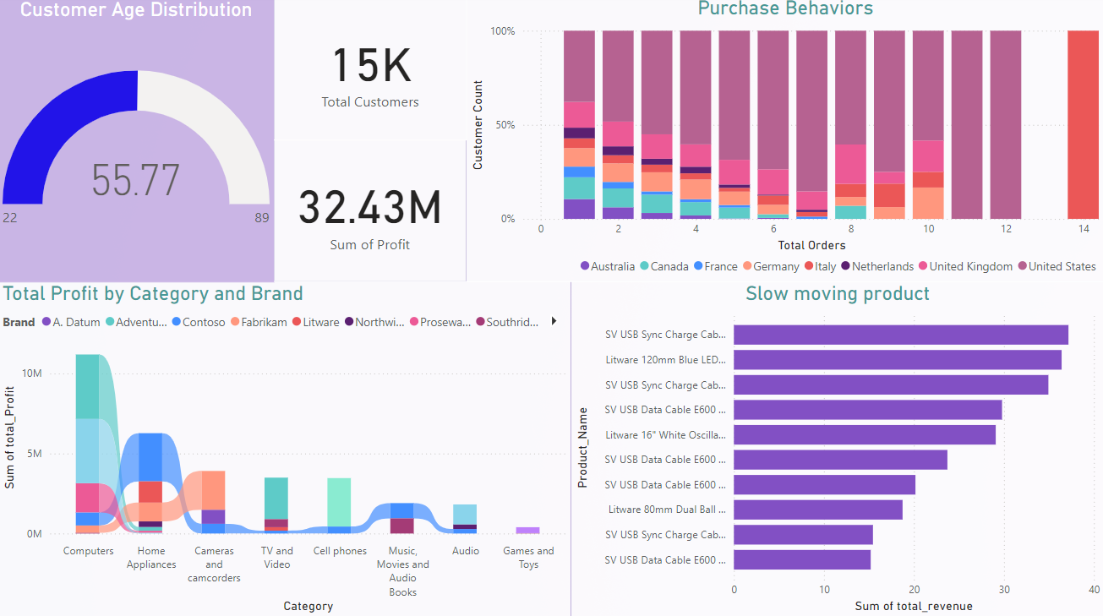
Key Insights
Customer Age Distribution: The average customer age is 55.77, suggesting a mature customer base.
Purchase Behaviors: The chart shows the distribution of purchase counts for different customer groups.
Total Profit by Category and Brand: Computers and Home Appliances are the top-performing categories in terms of total profit.
Slow-Moving Products:
Product Identification: The dashboard highlights slow-moving products based on their total revenue.
Product Analysis: Analyzing these products can help identify reasons for low sales and explore potential strategies to improve their performance.

Slide 11
Thank you
Ashwini Murugappan
MDTM28
ashwinimurugappan@gmail.com

